Slide 1

Lessons[0] = “Getting started”;
Getting started with JavaScript

Slide 2
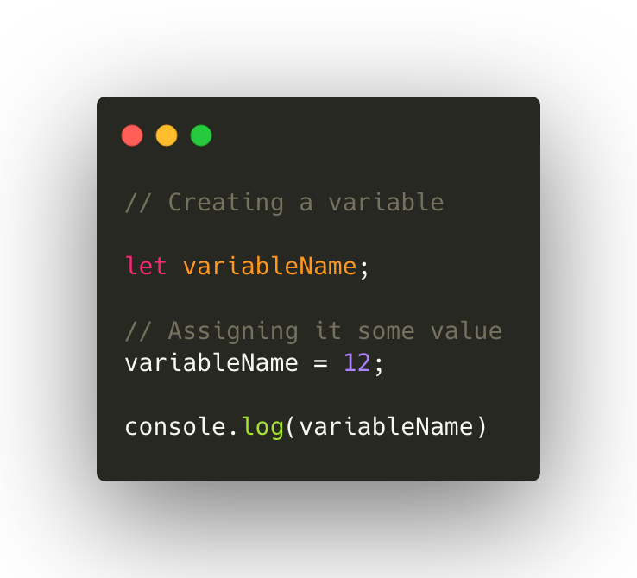
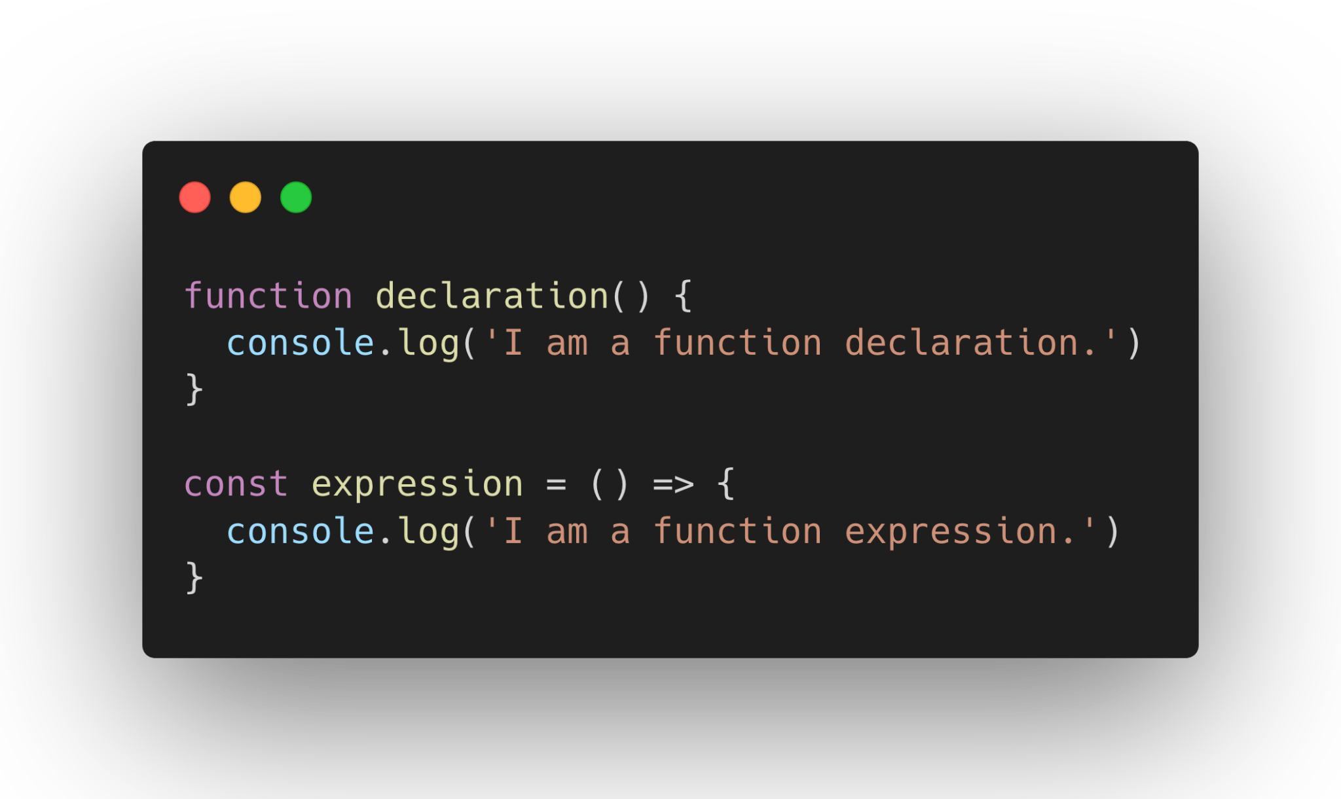
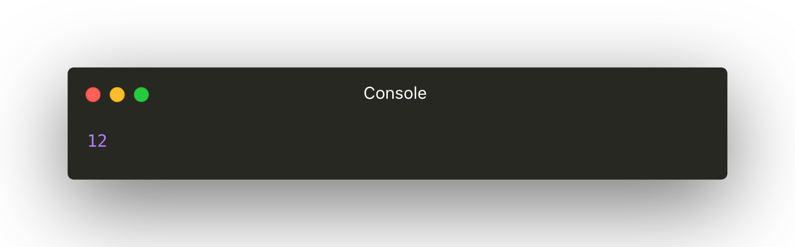
Example code presentation

Slide 3
Pointing out in code

Slide 4
Sample Javascript slide

Slide 5

Sample DOM slide

